Slide 1
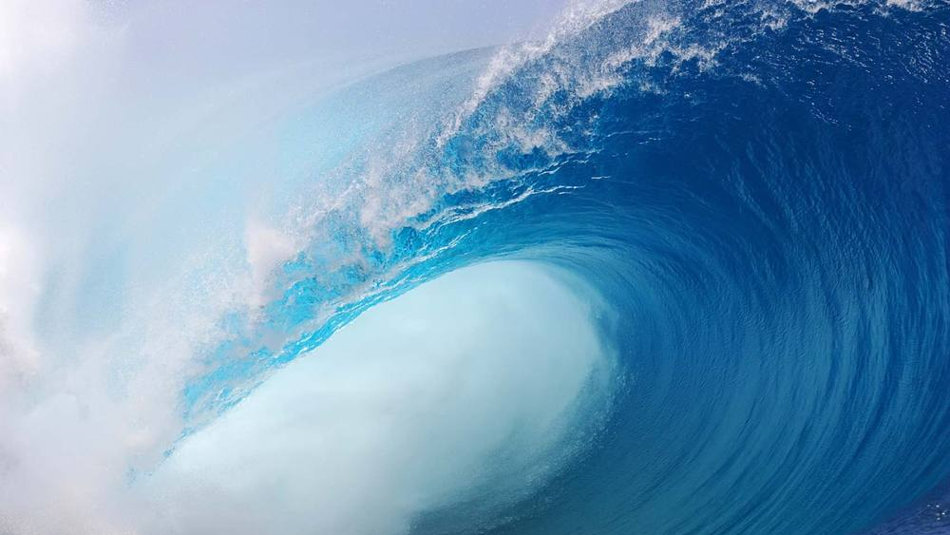
The POWER& Authority In Christians
Warfare Series
This Photo by Unknown Author is licensed under CC BY-SA

Slide 2
Introduction
In this third part of the warfare series, we will be examining the tremendous power, potential and authority invested in Believers through the Cross of Christ.
We have looked at the power of Satan and the supremacy of Christ, we will now see what the Scriptures have to say about our position in the spirit world after redemption.

Slide 3
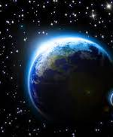
ON ANOTHER LEVEL!
6 And He raised us up together with Him [when we believed], and seated us with Him in the heavenly places, [because we are] in Christ Jesus, Ephesians 2:6

Slide 4
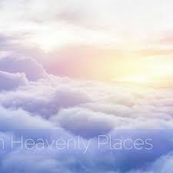
RAISED UP!!
If then you were raised with Christ, seek those things which are above, where Christ is, sitting at the right hand of God. Colossians 3:1

Slide 5
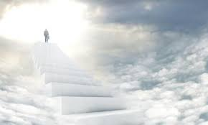
WHERE ARE WE SEATED EXACTLY?
20 which He worked in Christ when He raised Him from the dead and seated Him at His right hand in the heavenly places, 21 far above all principality[g] and [h]power and [i]might and dominion, and every name that is named, not only in this age but also in that which is to come. Ephesians 1:20
….seated us with Him in heavenly places Ephesians 2:6

Slide 6
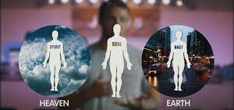
TRIPATITE MAN
Your Spirit in the spirit world is higher and above all other spiritual forces. While your body engages with the Earth.

Slide 7
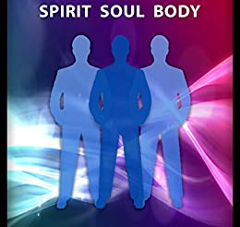
YOU ARE A SPIRIT!
But he who is joined to the Lord is one spirit with Him. 1 Corinthians 6:17

Slide 8
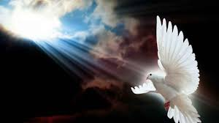
YOU ARE SPIRIT!
6 That which is born of the flesh is flesh, and that which is born of the Spirit is spirit. 7 Do not marvel that I said to you, ‘You must be born again.’ 8 The wind blows where it wishes, and you hear the sound of it, but cannot tell where it comes from and where it goes. So is everyone who is born of the Spirit.” John 3:6-8

Slide 9
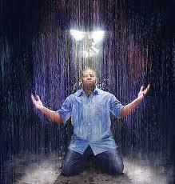
BORN OF GOD!
12 But as many as received Him, to them He gave the [e]right to become children of God, to those who believe in His name: 13 who were born, not of blood, nor of the will of the flesh, nor of the will of man, but of God.

Slide 10
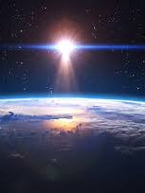
BORN OF GOD OVERCOMES THE WORLD
4 For whatever is born of God overcomes the world. And this is the victory that has overcome the world—[a]our faith. 5 Who is he who overcomes the world, but he who believes that Jesus is the Son of God? 1 John 5:4
Satan, the god of this world….2 Corinthians 4:4

Slide 11
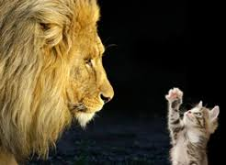
GREATER IS HE WITHIN!
4 You are of God, little children, and have overcome them, because He who is in you is greater than he who is in the world. 1 John 4:4

Slide 12
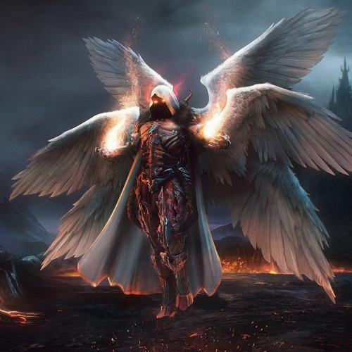
ANGELS IN CHARGE
For He shall give His angels charge over you, To keep you in all your ways. 12 In their hands they shall [c]bear you up,Lest you [d]dash your foot against a stone.
13 You shall tread upon the lion and the cobra,The young lion and the serpent you shall trample underfoot. Psalm 91

Slide 13
ANGELS IN CHARGE
Are not all the angels' ministering spirits sent out [by God] to serve (accompany, protect) those who will inherit salvation? Hebrews 1:14

Slide 14
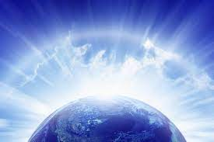
WHATEVER YOU BIND….
18 I assure you and most solemnly say to you, whatever you bind [forbid, declare to be improper and unlawful] on earth [f]shall have [already] been bound in heaven, and whatever you loose [permit, declare lawful] on earth [g]shall have [already] been loosed in heaven. Matthew 18:18

Slide 15
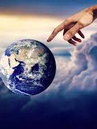
Whatever you bind!
19 “Again I say to you, that if two [h]believers on earth agree [that is, are of one mind, in harmony] about anything that they ask [within the will of God], it will be done for them by My Father in heaven. 20 For where two or three are gathered in My name [meeting together as My followers], I am there among them.” Matthew 18:19

Slide 16
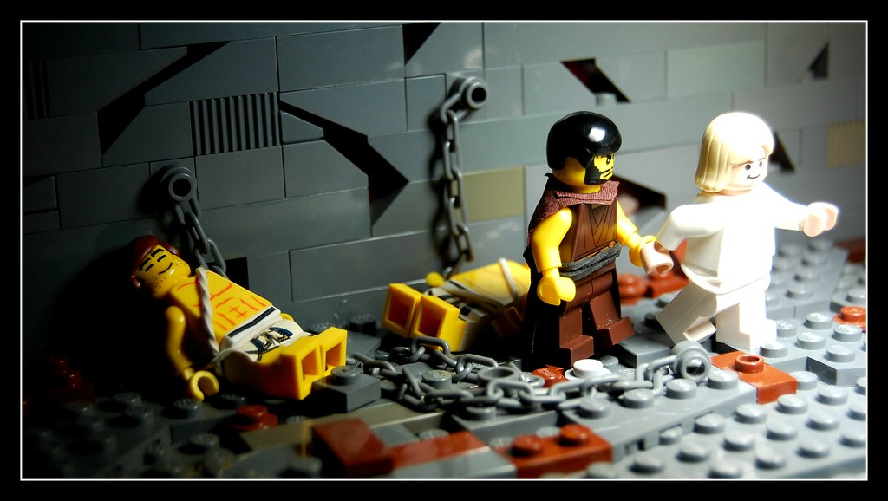
POWER TO LOOSEN!
5 So Peter was kept in prison, but fervent and persistent prayer for him was being made to God by the church.
7 Suddenly, an angel of the Lord appeared [beside him] and a light shone in the cell. The angel struck Peter’s side and awakened him, saying, “Get up quickly!”
And the chains fell off his hands

Slide 17
PRAYER POWER!
Then the angel told him, “Put on your robe and follow me.” 9 And Peter went out following the angel. He did not realize that what was being done by the angel was real, but thought he was seeing a vision. 10 When they had passed the first guard and the second, they came to the iron gate that leads into the city. Of its own accord it swung open for them; and they went out and went along one street, and at once the angel left him. Acts 12:8-10

Slide 18
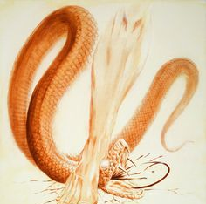
Trample on snakes!
19 Listen carefully: I have given you authority [that you now possess] to tread on [d]serpents and scorpions, and [the ability to exercise authority] over all the power of the enemy (Satan); and nothing will [in any way] harm you. Luke 10:19

Slide 19
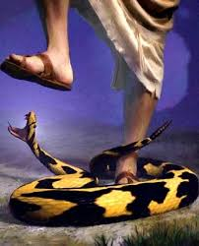
Total authority!
Now Jesus called together the twelve [disciples] and gave them [the right to exercise] power and authority over all the demons and to heal diseases. Luke 9:1

Slide 20
Go in my authority!!
18 Jesus came up and said to them, “All authority (all power of absolute rule) in heaven and on earth has been given to Me. 19 Go therefore and make disciples of all the nations [help the people to learn of Me, believe in Me, and obey My words], baptizing them in the name of the Father and of the Son and of the Holy Spirit, Matthew 28:18

Slide 21
Go therefore!
15 And He said to them, “Go into all the world and preach the gospel to all creation. 16 He who has believed [in Me] and has been baptized will be saved [from the penalty of God’s wrath and judgment]; but he who has not believed will be condemned.
17 These signs will accompany those who have believed: in My name they will cast out demons, they will speak in new tongues; 18 they will pick up serpents, and if they drink anything deadly, it will not hurt them; they will lay hands on the sick, and they will get well.”

Slide 22
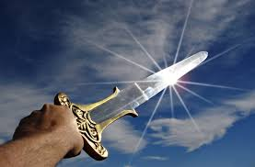
The sword of the spirit
3 For though we walk in the flesh [as mortal men], we are not carrying on our [spiritual] warfare according to the flesh and using the weapons of man. 4 The weapons of our warfare are not physical [weapons of flesh and blood]. Our weapons are divinely powerful for the destruction of fortresses 2 Corinthians 10:3-4

Slide 23
The armour!!
¹¹ Put on the full armor of God [for His precepts are like the splendid armor of a heavily-armed soldier], so that you may be able to [successfully] stand up against all the schemes and the strategies and the deceits of the devil. ¹² For our struggle is not against flesh and blood [contending only with physical opponents Ephesians 6

Slide 24
The armour!!
but against the rulers, against the powers, against the world forces of this [present] darkness, against the spiritual forces of wickedness in the heavenly (supernatural) places.
13 Therefore, put on the complete armor of God, so that you will be able to [successfully] resist and stand your ground in the evil day [of danger], and having done everything [that the crisis demands], to stand firm [in your place, fully prepared, immovable, victorious]. Ephesians 6

Slide 25
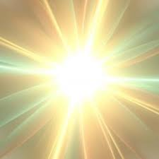
YOU ARE LIGHT!
“You are the light of [Christ to] the world. A city set on a hill cannot be hidden;
Matthew 5:14

Slide 26
YOU ARE LIGHT!
5 The light shines in the darkness, and the darkness has not overcome it.
John 1:5

Slide 27
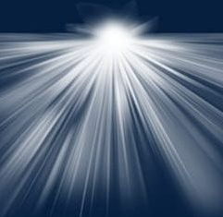
YOU ARE THE LIGHT!!
See, darkness covers the earth and thick darkness is over the peoples, but the Lord rises upon you and his glory appears over you. Isaiah 60:2

Slide 28
HOMEWORK
READ COLOSSIANS THROUGH
List at least 10 other abilities, strengths or power of Christians according to scripture.

