Slide 1
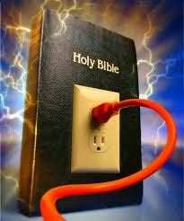
UNLOCKING THE POWER IN THE WORD

Slide 2
In these sessions we will be reminding ourselves about the awesome LIFE in the Word

Slide 3
REFLECTION
How wholesome has been your Bible digestion over the last week or few days?

Slide 4
The enemy conspires with your Flesh and the World to form an unholy trinity whose sole aim is to block your access to the Life in the Scriptures.

Slide 5
Think about it: why do you find so little time for Bible Study?

Slide 6
Let us now look at Top Ten benefits of the Scriptures in your Life.

Slide 7
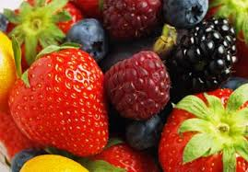
10. FLOURISHING
But his delight is in the law of the Lord,
And in His law, he meditates day and night.
³ He shall be like a tree
Planted by the rivers of water,
That brings forth its fruit in its season,
Whose leaf also shall not wither;
And whatever he does shall prosper.
Psalm 1:3

Slide 8
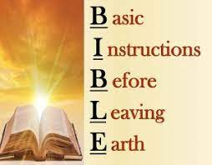
9. INSTRUCTION
¹⁶ All Scripture is given by inspiration of God, and is profitable for doctrine, for reproof, for correction, for ^{[c]}instruction in righteousness, ¹⁷ that the man of God may be complete, thoroughly equipped for every good work
2 Timothy 3:16

Slide 9
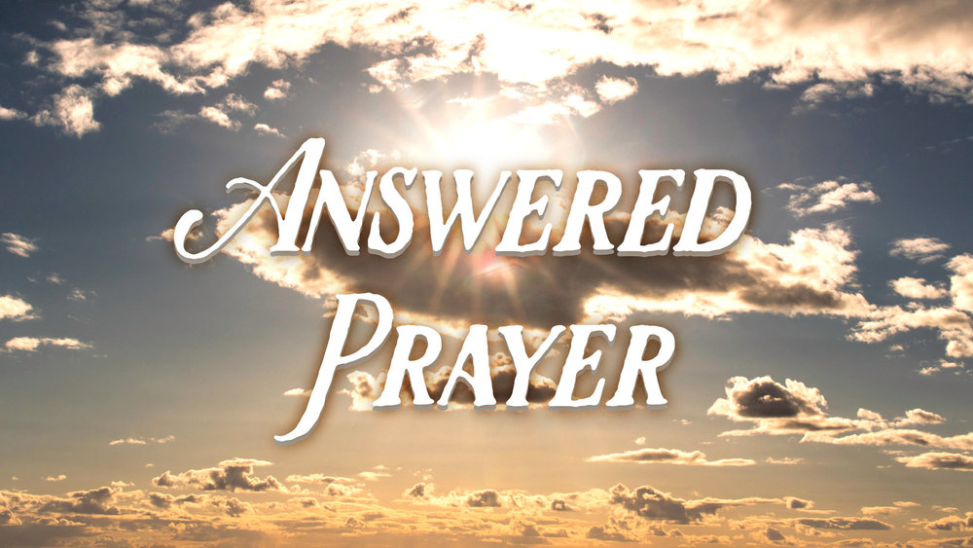
8. ANSWERED PRAYER
⁷ If you abide in Me, and My words abide in you, you will ask what you desire, and it shall be done for you.
John 15:7

Slide 10
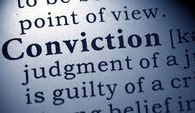
7.CONVICTION/CORRECTION
The law of the Lord is perfect, converting the soul: the testimony of the Lord is sure, making wise the simple.
Psalm 19:7

Slide 11
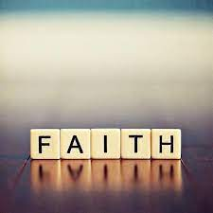
6.STRONG FAITH
So, faith comes from hearing, and hearing through the word of Christ.
Rom. 10:17

Slide 12
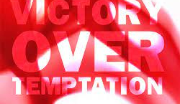
5. VICTORY OVER TEMPTATION
I have stored up your word in my heart, that I might not sin against you .
Psa. 119:11

Slide 13
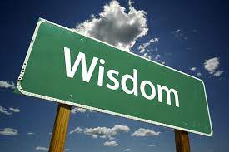
4.WISDOM
I have more understanding than all my teachers, for your testimonies are my meditation.
Psa. 119:99

Slide 14
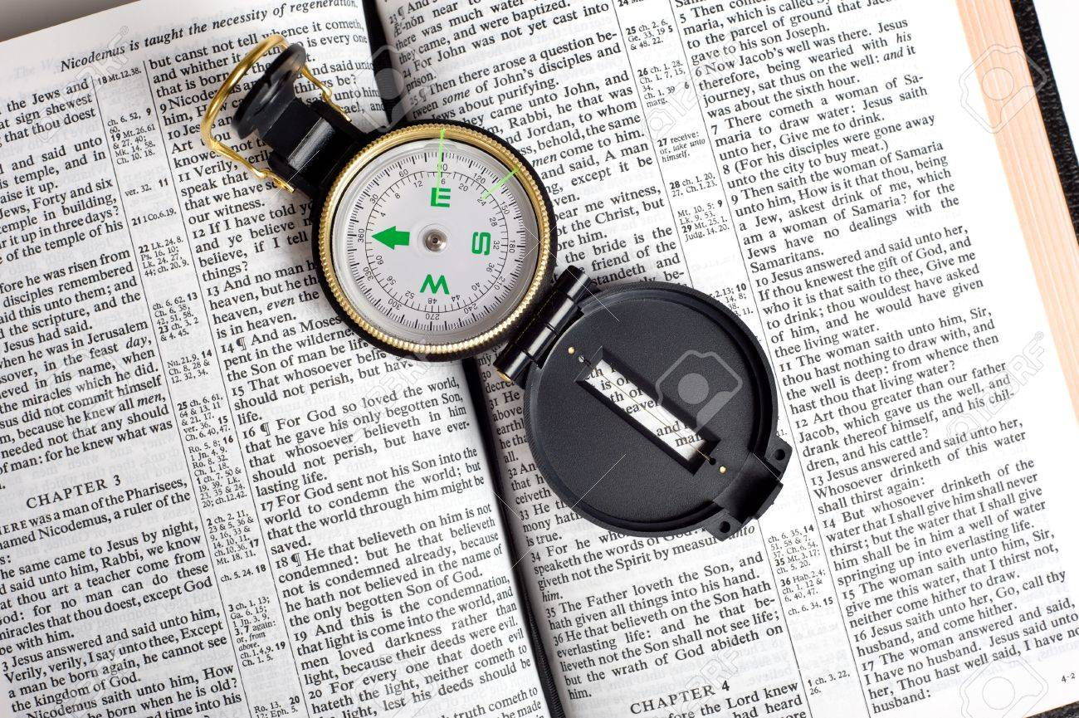
3. DIRECTION
Your word is a lamp to my feet and a light to my path.
Psa. 119:105

Slide 15
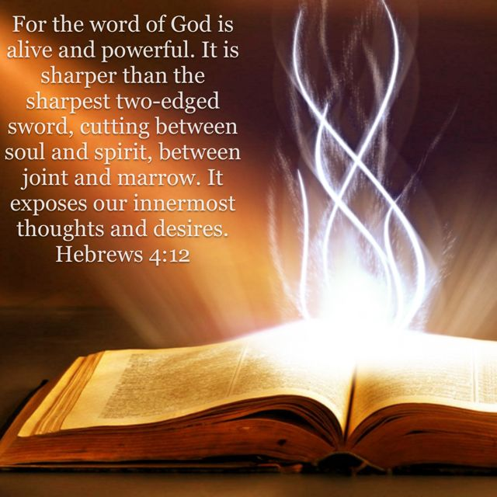
2. THE WORD IS ALIVE!

Slide 16
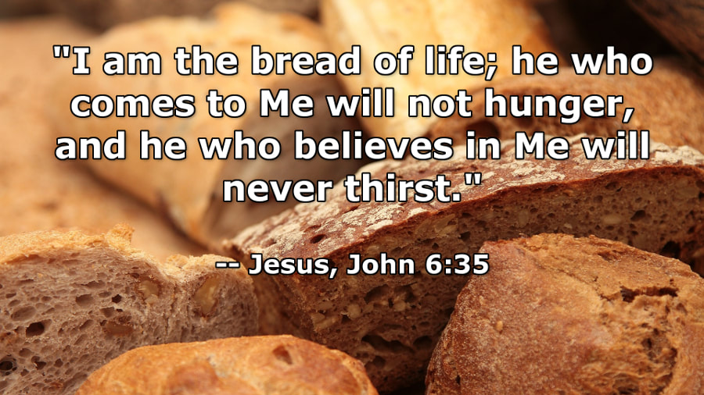
1. NOURISHMENT

Slide 17
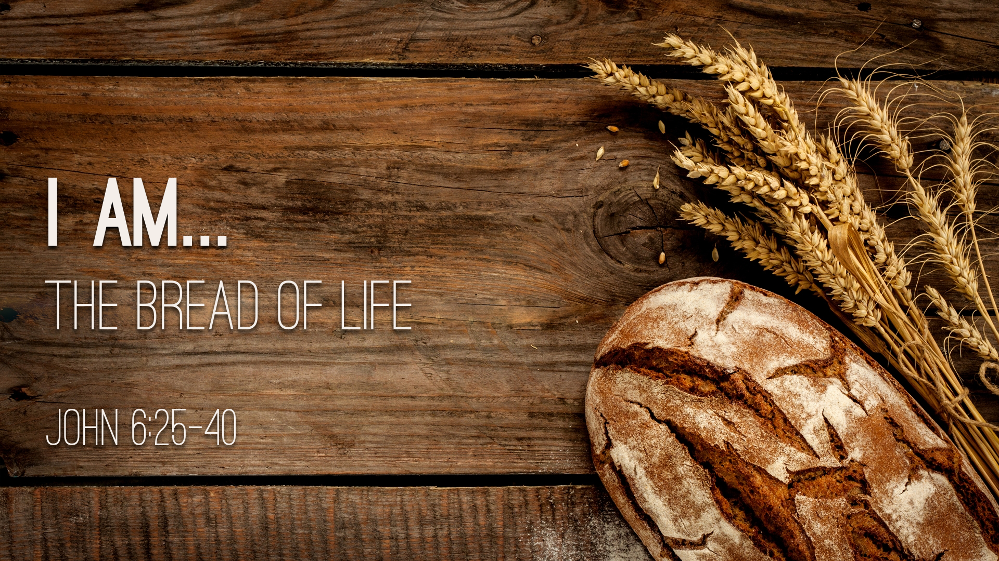
NOURISHMENT

